Slide 1
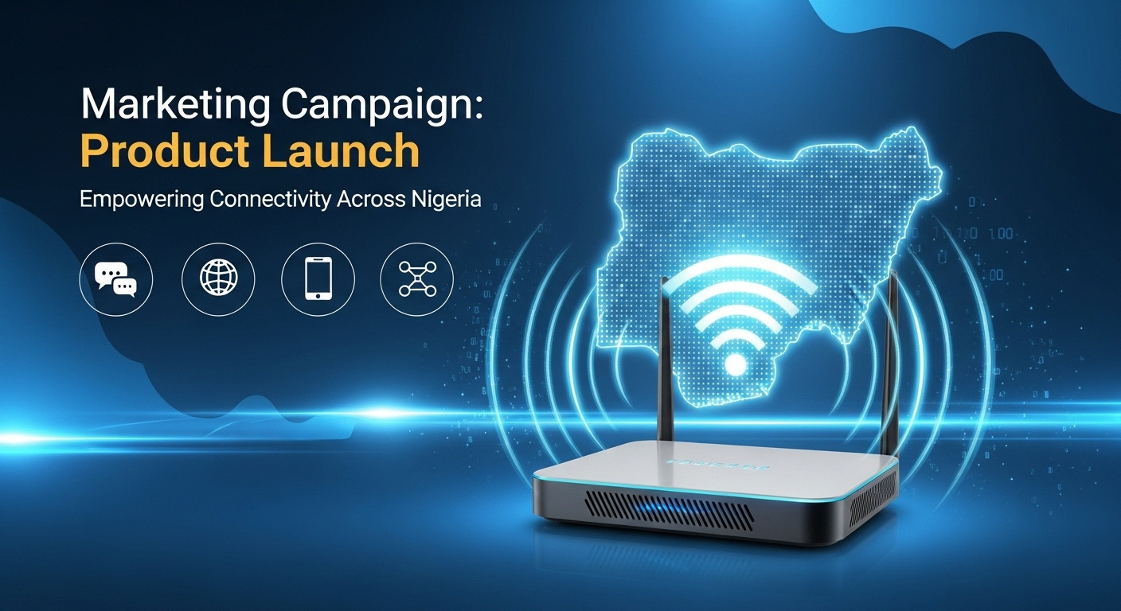
TEL-DATA-MAX
Presentation date: 28th October 2025

Slide 2
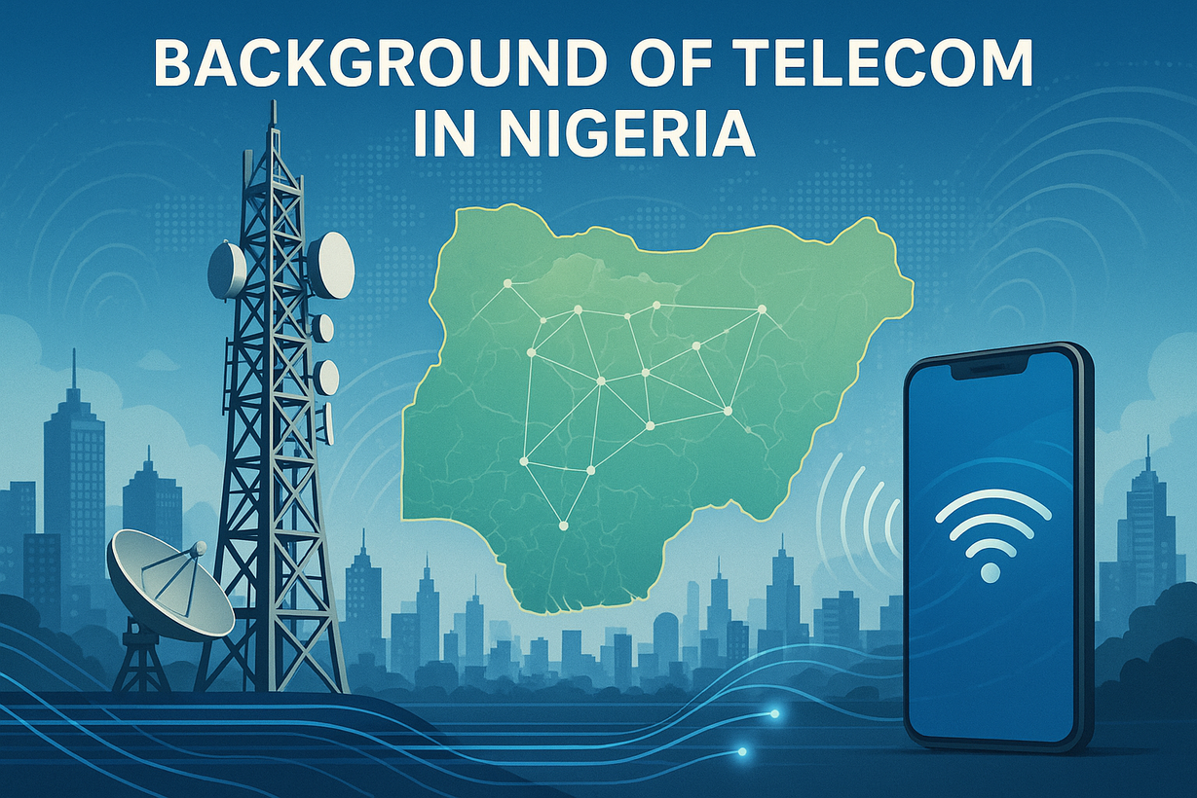

NEW PRODUCT LAUNCH
MARKETING CAMPAIGN
Background
Nigeria’s telecommunications industry has undergone rapid evolution since the early 2000s. What began with basic landlines and cell phones has grown into a fully digital ecosystem powered by smartphones and high-speed internet. The rise of mobile technology turned SIM cards from simple tools for making calls into essential gateways for internet access.
Over time, we’ve seen steady progress — from 2G networks to 3G, 4G, and now 5G. This growth has built a market driven by broadband connectivity and digital demand.
Today, Nigeria’s SIM market stands at about 169 million subscribers, with nearly 50% using 4G networks. The main players include MTN, Airtel, Glo, Spectranet, Starlink, and Smile. MTN leads with roughly 52% market share, followed by Airtel (33.4%), Glo (12%), and smaller providers sharing the remaining percentage. These smaller competitors stay relevant by offering niche services and unique value that attract loyal customers.
To compete meaningfully, we must design a product that appeals to the broader 4G user segment — which represents half of the market — rather than fighting over the shrinking 1% share occupied by niche providers. Our strategy should target everyday users seeking reliability, speed, and value.
The campaign should take into consideration the complexity of the audience segment and focus on local media.

Slide 3
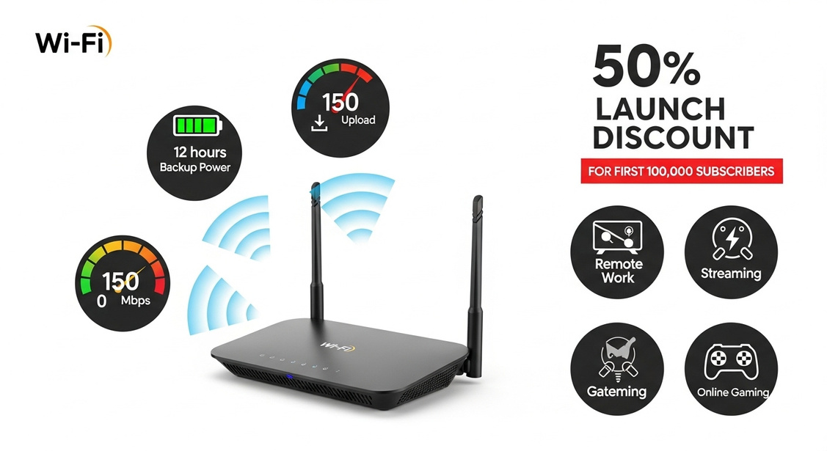
NEW PRODUCT LAUNCH
MARKETING CAMPAIGN
Assumptions (Unique Selling Points)
  The router comes with a built-in power pack that lasts up to 12 hours without electricity.
  It delivers download speeds up to 150 Mbps and upload speeds up to 50 Mbps, making it ideal for streaming, remote work, and gaming.
  At launch, we’ll offer a 50% discount to the first 100,000 subscribers, creating a strong incentive for early adoption and driving rapid market penetration.

Slide 4
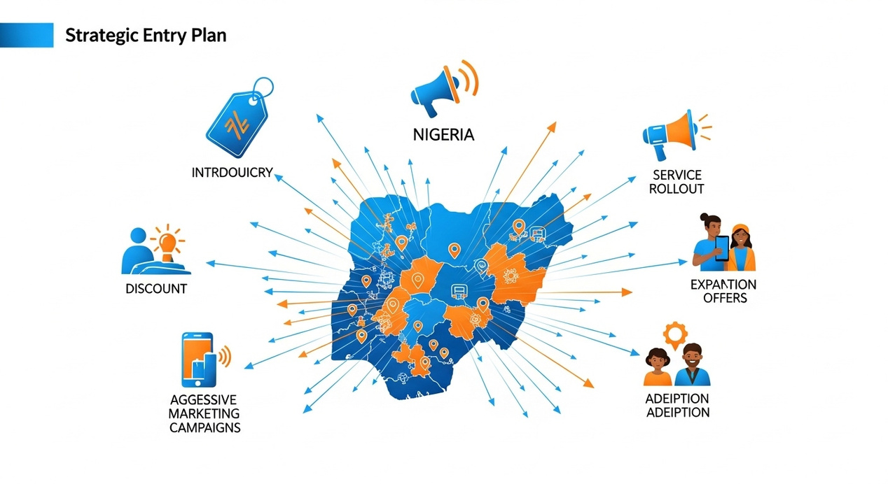
NEW PRODUCT LAUNCH
MARKETING CAMPAIGN
Q4 2023
Develop a Strategy and Media Plan on how you will achieve the objectives of this campaign online.
  Market Penetration Strategy for New Telecom Provider (4G Router Focus)
  Target Audience Breakdown
Urban & Semi-Urban Families and Households (Target: Lagos, Abuja,
Port Harcourt, Kano, Ibadan, Onisha, Enugu )
  Income Class: B, C1, C2 classes
  Pain Points: Reliable, affordable, and fast internet for everyday use
use (work-from-home, online learning, streaming, social media, etc.)
  Behavior: Cost-conscious, value-focused,
with moderate to high data consumption.
2. Business Owners in Major Cities
  Income Class: B, C1
  Pain Points: Dependable and scalable internet for small businesses,
remote offices, and point-of-sale systems.
  Behavior: Cost-effective solutions, consistent speed,
and reliable service during working hours.

Slide 5
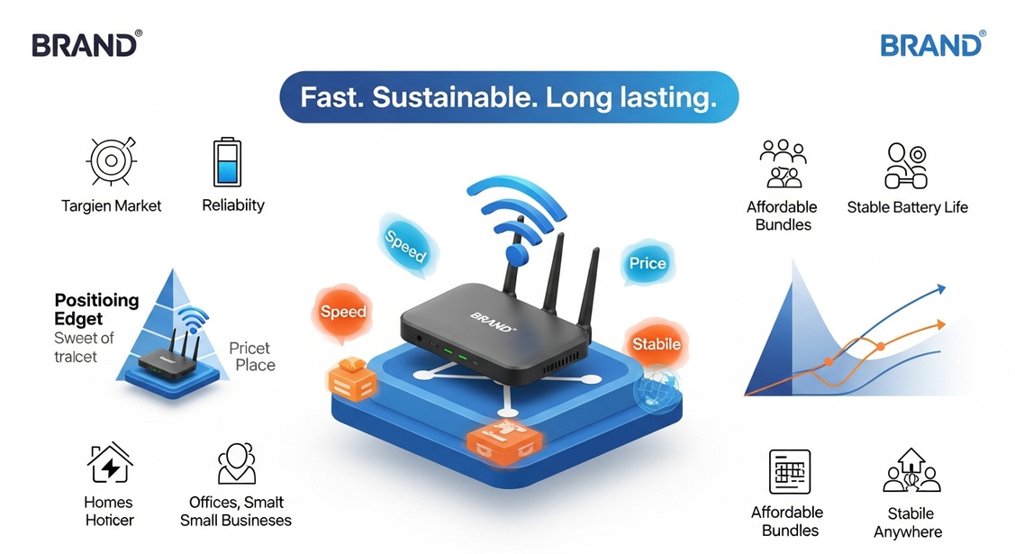
NEW PRODUCT LAUNCH
MARKETING CAMPAIGN
Q4 2023
POSITIONING & VALUE PROPOSITION
  Slightly Cheaper Than Competitors: Offering a competitive price point (around ₦10,000–₦20,000 for basic 4G routers) to attract price-sensitive customers while offering a basic but reliable service.
2. Targeting Entry-Level Broadband: Catering to households and small businesses who have yet to adopt broadband solutions.
Minimal Upfront Cost: Lower setup costs and pay-as-you-go data packages, especially for new-to-internet customers.
3. Bundled Services
Incentivized Data Bundles: Provide affordable data packages, for the prelaunch phase and post phase, giving a 50% discount on for current packages to incentivize early sign-ups, till we get to 100,000 subsribers
4. Service Stability & Speed (4G as a baseline):
Emphasize 4G speed capabilities (up to 150Mbps upload and 50Mbps download speed), which is adequate for daily streaming, small office work, and e-learning.
5. Battery life:
Router has a battery life of 12hours without power, helping to take advantage of the inconsistent power and turning it into a postive

Slide 6
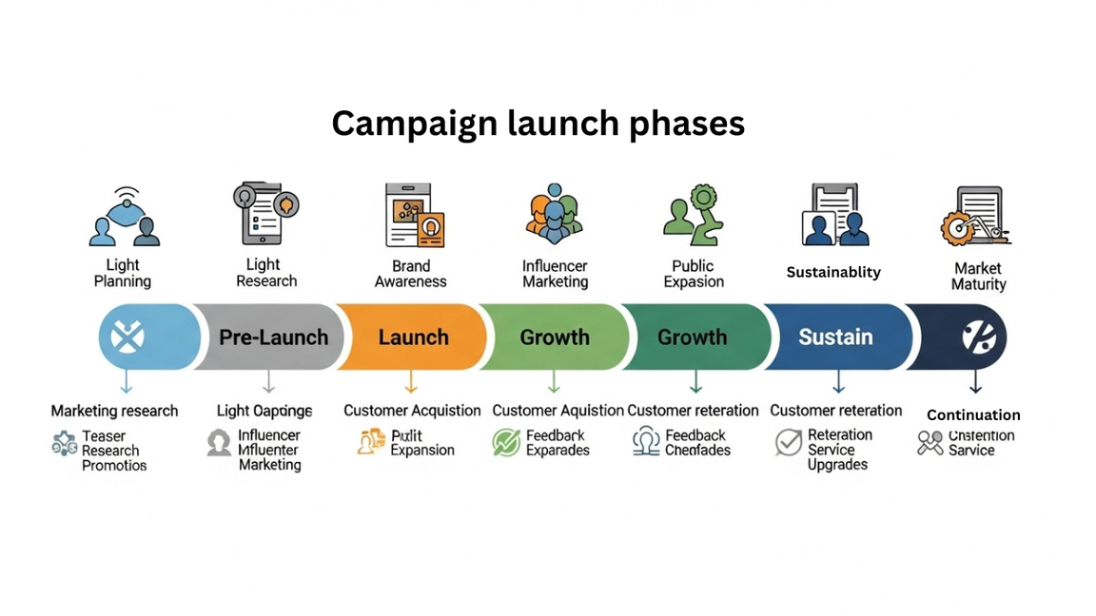
NEW PRODUCT LAUNCH
MARKETING CAMPAIGN
TIMELINE & CAMPAIGN PHASES
Pre-Launch (Months 1–3)
Market Research & product review:
  Perform in-depth analysis on competitors (MTN, Airtel, Glo, Spectranet) to understand pricing structures, subscriber packages, and USPs.
  Collect feedback from target customers in major cities via online influencers, tech reviewer, online gamers, popular businesses inflencers and family creators.
We would ask to both review with as many videos as possible, offering our free products and bundles as well. Once they make reviews, we would have data from the influencers that used it in the major cities and good traction for the products.
  Branding & Awareness:
    Create brand assets (logos, colors, guidelines etc.) with a focus on affordability and reliability.
    Develop a compelling campaign with a tagline “Stay Productive, Stay Connected.”
    Launch a teaser campaign and influencer review videos posted on all social media platforms, and digital ads, in key cities. Talking about the product, using the positive reviews from the influencers to launch a countdown for the event proper.
    Go on a podcast tours to also create awareness of not just positives of our products, event coming up and even offer to power the internet services needed for a week after our arrival.

Slide 7
NEW PRODUCT LAUNCH
MARKETING CAMPAIGN
Customer retention (Months 5–6)
ustomer Acquisition & Retention:
    Target the B, C1, C2 classes by running local targeted ads and focusing on cost-effective and value-driven campaigns.
  Partnerships on the ground marketing:
    Partner with apartment complexes, street and closes offering bulk service deals for residents, focusing on affordable home broadband.
    Engage local businesses with tailored packages for small and medium enterprises (SMEs), offering them more data and connectivity features.
  Social Media Engagement:
    Regularly run giveaways and contests to increase social media engagement, and more influencer content.
    Content marketing on platforms like Facebook, Instagram,tiktok, and youtbe focusing on tutorial videos, user success stories, launch countdown and more
  Customer Support & Feedback:
    Establish a 24/7 customer support hotline and online chat support.
    Collect user feedback to continuously improve the service and build loyalty.
KEY MARKETING CHANNELS
  Product Launch (Month 4)
Launch Event:
  Organize virtual and physical launch events across cities to promote the product.
  Collaborate with local influencers, tech bloggers, news channels and small business owners to provide testimonials go live for the event day eg Ishowspeed streaming while also having a wrestlemaina moment. That way we would make a whole lot of noise which would bring eyes
Promotions & Discounts:
  Launch with attractive bundles and packages.
  Officallly announce our plan to disrupt the market and offer discounts for the first 100,000 subscribers in major cities.
Referral Program:
  Launch a refer-a-friend program where users earn extra data by referring others, targeting the family and business audience.

Slide 8
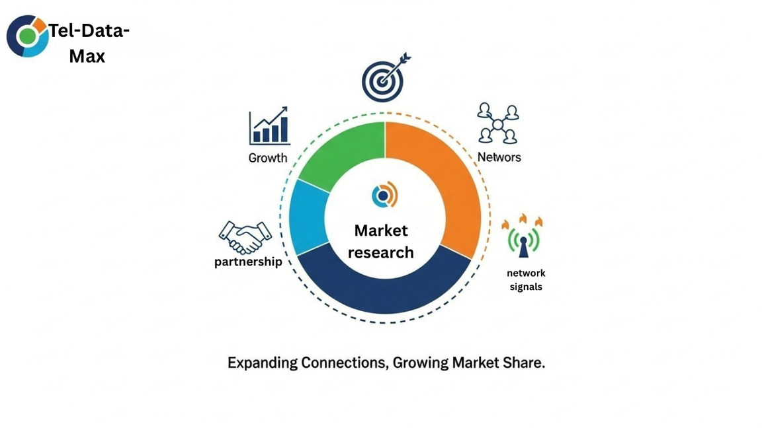
NEW PRODUCT LAUNCH
MARKETING CAMPAIGN
MARKET SHARE STRATEGY
KEY MARKETING CHANNELS
Assuming the current market is dominated by the top 3 players (MTN, Airtel, Glo), the new telecom company’s goal would be to capture a 10–15% market share within the first 6 months. Here’s how:
  Target Market Segmentation:
    Focus on households, individuals, and business owners in major cities who are underserved or dissatisfied with current providers.
    Promote the entry-level, value-focused broadband plan to attract first-time internet users or customers considering a switch.
2. Penetration Strategy:
    Initially, the company may capture 5% of the existing 4G broadband market (based on 169 million subscribers and 50% broadband penetration), which equates to 4.23 million potential customers.
    If targeting new customers and offering attractive packages, it can likely acquire 400,000–600,000 customers in the first 18 months. Also, due to the fact that we are offering a 50% discount to the first 100,000 subscribers.
3. Retention & Growth:
    Gradually increase market share by adding higher-speed options (e.g., high-value data bonus, faster internet connection within 12–18 months) to attract tech-savvy customers and businesses seeking faster speeds.
    Periodic post-purchase surveys of our subscribers make sure we get as much information from them as possible regarding our products, both positive and negative.
  Digital Advertising: Focus on social media platforms (Facebook, Instagram, x, TikTok, and Google Ads) and local SEO for major cities.
2. Influencer Partnerships: Collaborate with local influencers, bloggers, and business owners who double as influencers to build credibility and trust

Slide 9
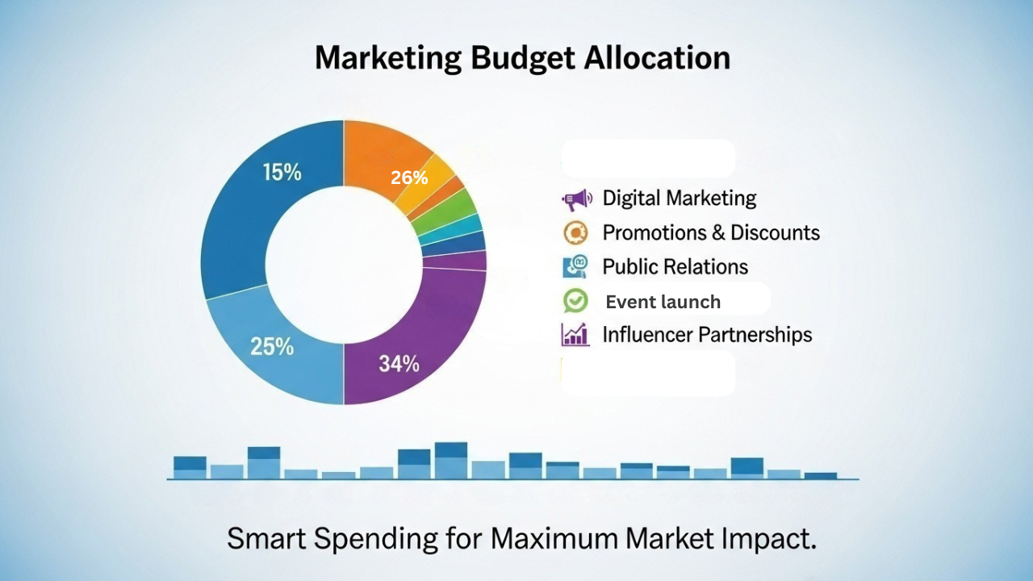
NEW PRODUCT LAUNCH
MARKETING CAMPAIGN
BUDGET BREAKDOWN FOR MARKETING CAMPAIGN (₦30 MILLION)
1. Digital Advertising (₦7 million)
  Social Media Ads (Facebook, Instagram, Twitter and tiktok): ₦4 million
    Target Audience: Families, households, small business owners, and early adopters.
    Focus: Build brand awareness and drive conversions with targeted campaigns promoting affordable 4G routers.
    Platforms: Facebook Ads, Instagram Stories, Twitter Ads.
    Expected Reach: Focus on major cities like Lagos, Abuja, Port Harcourt, and Kano.
  Google Ads (Search & Display): ₦1 million
    Target Audience: Customers searching for home broadband solutions.
    Focus: Pay-per-click (PPC) for keywords like “affordable internet,” “4G home broadband,” “best internet for small business,” etc.
    Expected Outcome: Drive traffic to landing pages and product sign-ups.
  YouTube & Video Ads: ₦1 million
    Target Audience: Customers engaging with tech-related video content or product reviews.
    Focus: Promote short 20 – 40 second ads showcasing product benefits (speed, price).
  Google Display Network: ₦1 million
    Target Audience: People browsing tech and broadband-related content.
    Focus: Banner ads and display ads to increase brand visibility and remind potential customers of promotions.

Slide 10
NEW PRODUCT LAUNCH
MARKETING CAMPAIGN
2. Influencer Marketing (₦ 8 million)
  Local Influencers, Micro-Influencers, and business influencers: ₦7 million
    Target Audience: Tech enthusiasts, young families, and small business owners.
    Focus: Partner with 20–30 influencers who cater to families, tech-savvy users, and entrepreneurs to promote your product. Affiliate programs.
    Expected Outcome: Trust-building, product endorsements, podcast tours, and increased engagement.
    Content: Instagram and YouTube content showcasing how the new router fits into the daily life of the influencer (i.e., work-from-home, streaming, etc.).
  Community Engagement: ₦1 million
    Focus: Create localized giveaways or competitions where influencers host events and offer free routers or discounts to fans.
4. Referral Program (₦3 million)
  Referral Bonuses: ₦ 3million
    Target Audience: Existing customers and new users who refer their family/friends to buy the product and prizes
    Incentive: Offer extra data or discounts to customers who refer new users.
  Expected Results: Organic growth, word-of-mouth marketing, and cost-effective customer acquisition, and affiliate programme.
5. Customer Support & Retention (₦6 million)
  Customer Support Setup: ₦2million
    Focus: Establish a 24/7 helpline, chatbots, and social media support to ensure smooth onboarding and provide quick solutions.
  Feedback & Surveys: ₦2m
    Focus: Collect customer feedback through surveys and follow-ups to continuously improve product offerings.
  Loyalty Program: ₦2 million
    Focus: Develop a loyalty program where long-term customers earn points that they can redeem for discounts, data, or future purchases.
6. Event budget (₦2 million)
  Event day budgeting and plan: ₦2million
Focus: Planning, execution, and management of the event launch.
🎯 Total Budget Allocation (₦30 Million)
  Digital Advertising: ₦7 million
  Influencer Marketing: ₦8 million
  Content Marketing & SEO: ₦4 million
  Referral Program: ₦3million
  Customer Support & Retention: ₦6 million
6. Event budget: ₦2 million
3. Content Marketing & SEO (₦3 million)
Website Development & Landing Pages: ₦2 million
Focus: Create optimized landing pages for specific offers, with clear calls to action, simple sign-up forms, and payment options.
Blogging & SEO Content: ₦500,000
Focus: Publish blog posts around affordable broadband solutions, comparison of broadband routers, and home internet tips to attract organic traffic.
Email Marketing: ₦500,000
Focus: Build an email list from website visitors, store sign-ups, and social media campaigns. Send targeted email campaigns & subscriptions with promotions, tutorials, and exclusive deals.

Slide 11
NEW PRODUCT LAUNCH
MARKETING CAMPAIGN
MONITORING FRAMEWORK FOR CAMPAIGN
Expected Outcomes
  Brand Awareness: Through a strong presence on social media and, influencer marketing campaign, the company will achieve significant visibility in major cities.
  Customer Acquisition: With affordable pricing, referral incentives, and a strong influencer campaign, the company can expect to acquire 100,000-400,000 subscribers within the first 6 months.
  Retention: Ongoing efforts with customer support, loyalty programs, and feedback loops will help retain customers and reduce churn.
  . Key Performance Indicators (KPIs)
  Brand Awareness:
    Reach: Number of people who have seen the campaign (ad impressions).
    Engagement: Social media likes, shares, comments, and interactions with ads.
    Website Traffic: Number of visitors, bounce rate, and session duration on landing pages or campaign-specific pages.
    Social Media Mentions: Volume of mentions and hashtags related to the campaign.
  Customer Acquisition:
    Conversion Rate: Percentage of website visitors or leads that convert into paying customers.
    Lead Generation: Number of people signing up for a trial, newsletter, or using referral links.
    New Customer Sign-Ups: Total number of new customers acquired through the campaign.
  Sales & Revenue:
    Revenue from Campaigns: Total revenue generated from sales directly attributed to campaign efforts.
    ROI (Return on Investment): Revenue compared to the total campaign spend (e.g., ₦30 million).
  Customer Retention:
    Churn Rate: Percentage of customers who cancel the service within the campaign duration.
    Customer Lifetime Value (CLV): Total revenue from customers who remain after the campaign.
    Customer Satisfaction: Feedback and ratings via surveys, support channels, and social media sentiment.

Slide 12
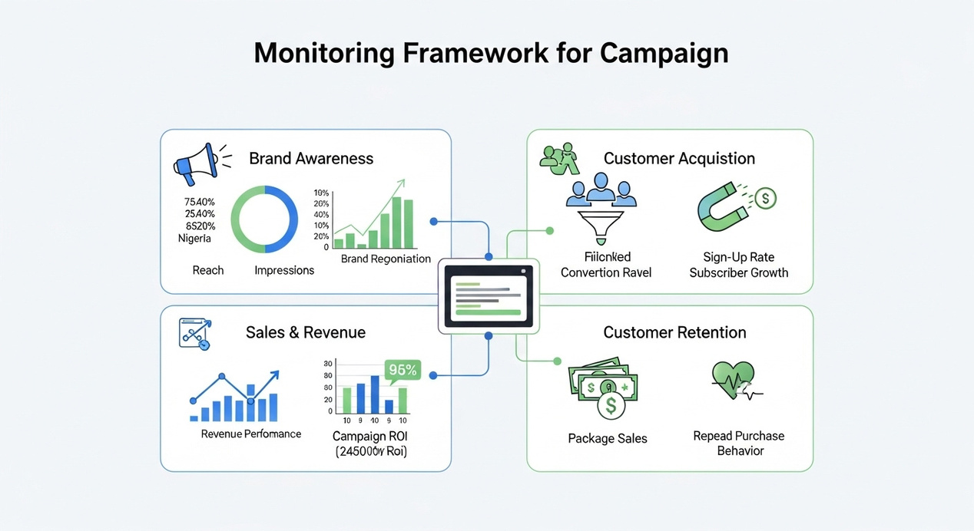
NEW PRODUCT LAUNCH
MARKETING CAMPAIGN
MONITORING FRAMEWORK FOR CAMPAIGN
  . Key Performance Indicators (KPIs)
  Brand Awareness:
    Reach: Number of people who have seen the campaign (ad impressions).
    Engagement: Social media likes, shares, comments, and interactions with ads.
    Website Traffic: Number of visitors, bounce rate, and session duration on landing pages or campaign-specific pages.
    Social Media Mentions: Volume of mentions and hashtags related to the campaign.
  Customer Acquisition:
    Conversion Rate: Percentage of website visitors or leads that convert into paying customers.
    Lead Generation: Number of people signing up for a trial, newsletter, or using referral links.
    New Customer Sign-Ups: Total number of new customers acquired through the campaign.
  Sales & Revenue:
    Revenue from Campaigns: Total revenue generated from sales directly attributed to campaign efforts.
    ROI (Return on Investment): Revenue compared to the total campaign spend (e.g., ₦30 million).
  Customer Retention:
    Churn Rate: Percentage of customers who cancel the service within the campaign duration.
    Customer Lifetime Value (CLV): Total revenue from customers who remain after the campaign.
    Customer Satisfaction: Feedback and ratings via surveys, support channels, and social media sentiment.

Slide 13
NEW PRODUCT LAUNCH
MARKETING CAMPAIGN
MONITORING PROCESS
  . Biweekly Report
    Review weekly KPIs like website traffic, conversions, social media engagement, and paid ad performance.
    Make necessary adjustments to paid campaigns or ad creatives based on performance.
2. Monthly Review
    Evaluate how well the campaigns are performing against KPIs. Identify what’s working and what’s not.
    Adjust strategies for influencer marketing, paid ads, and promotions to focus on the most effective tactics.
3. Mid-Campaign Optimization (Month 3)
    Use insights from the first 3 months to optimize campaigns.
    If certain strategies (e.g., influencer partnerships, paid ads) are performing well, allocate more budget to these areas.
4. End-of-Campaign Report (Month 6)
    Conduct a comprehensive analysis of the entire campaign performance.
    Compare actual performance to original goals (e.g., customer acquisition, sales, ROI).
Identify areas for improvement for future campaigns.
SUMMARY OF MONITORING TOOLS
  Google Analytics, ads, and tag manager: For website, ad setu, ad management, reporting and landing page performance.
  Meta Ads Manager: To track paid social media ad performance.
  Hootsuite/Buffer: For managing and analyzing social media content.
  Agency and track desk/Upfluence: For tracking influencer and referral performance.
  Zendesk/Freshdesk: To monitor customer support queries and sentiment.
  Google Sheets: To track ROI and budget allocation.
Email Campaign Monitoring: Mailchimp

